Slide 1
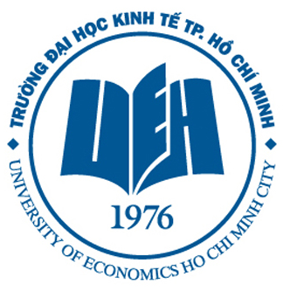
School of Economics
1A Hoang Dieu, Phu Nhuan District, Ho Chi Minh City
Scientifically Bringing Evidence to Policymakers with Respect and Responsibility in Research

Slide 2
Established in 1976
One of 14 key universities in Vietnam
One of 4 autonomous universities in Vietnam
Levels of education
Bachelor
Master
PhD

Slide 3
Schools
Economics
Management
International Business - Marketing
Public Finance
Finance
Banking
Accounting
Economic Mathematics - Statistics
Business Information Technology
Political Studies
Law
Government
Foreign Languages for Economics
Tourism

Slide 4
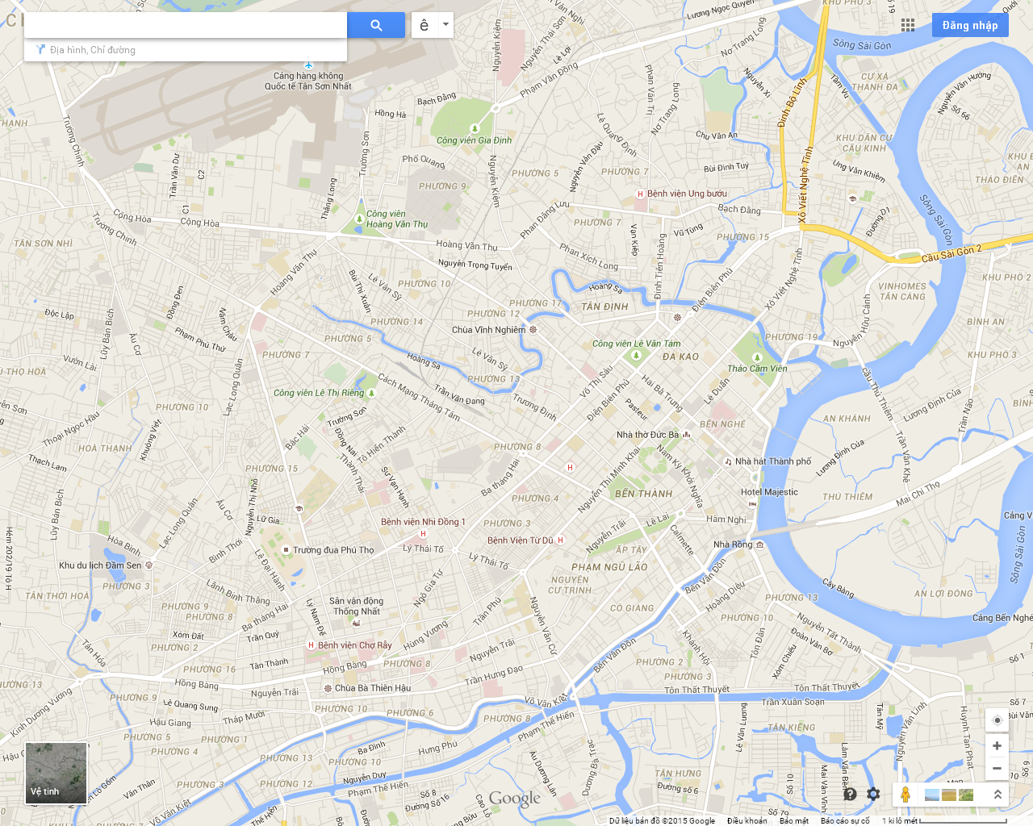
HO CHI MINH CITY
H
D
E
Guest house
A
C
NCT
THĐ
B
Dist 8
New campus
8 campuses, 2 dormitories and 1 guest house

Slide 5
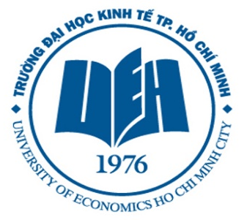
Organizational structure
14
Schools & faculty
15
Administrative
Departments
5
International Schools & Centers
15
International
Joint Programs
6
Research centers
and institutes

Slide 6
Research activities

Slide 7
Publications
Oxford Economic Papers
Land Use Policy
Resource and Energy Economics
Journal of Public Economics
The Journal of Economic Psychology
Journal of International Business Research
International Journal of Energy Economics and Policy
International Research Journal of Finance and Economics
Journal of Water, Sanitation and Hygiene for Development
Ecological Economics
Water Resource Research
Journal of Development Studies
Agricultural Economics
…

Slide 8
International Relations

Slide 9
School of Economics
Founded in 1993, as a merger of
Faculty of Planning – Pricing – Labor
Faculty of Agricultural and Rural Development
The first faculty of economics in Viet Nam.
Educational objective: to train young economists with basic and advanced economic knowledge, researching skills and experience in analyzing and evaluating public policies
Number of students: Undergraduate: 1,800 Postgraduate: 200
Number of permanent academic staff: 50

Slide 10
Staff
wide-range of academic specializations and well-trained at reputation universities in Vietnam and foreign countries
US, Sweden, Canada, Japan, Australia, New Zealand, Germany and the Netherlands

Slide 11
Undergraduate level
Applied Economics
Economics of Planning and Investment
Labor Economics and Human Resource Management
Agricultural Economics
Valuation
Real Estate Economics
Economic Management
Development Economics

Slide 12
Postgraduate level
Development Economics
Health Economics and Management
Economic Management
Valuation
Environmental Economics and Management

Slide 13
Research
Active researching teams.
Multi- and trans-disciplines with the various sources of funding (from Vietnamese government and international organizations such as IUCN, Sida, DANIDA, AusAID, USAID, IISD, UNDP, Newton and EEPSEA)
Bi-weekly Brown-bag “Small Talks Big Ideas” (STBI) seminars
School library with a wide range of books, journals and other academic materials.
Computer labs with high-speed internet and well-functioned local networks, served as important facilities for many behavioral experiments and economic analyses.

Slide 14
The Vietnam – Netherlands Programme
Established in 1994
A joint program with International Institute of Social Sciences, Erasmus University Rotterdam (the Netherlands)
Provide M.A. in Development Economics
60 credits, taught in English
Double degree: 6 months in the Netherlands
Upcoming: PhD joint program

Slide 15
The Vietnam – New Zealand Program
Established in 2002
A joint program with Victoria University of Wellington (New Zealand)
Degree: Bachelor of Commerce, 14 majors
3 years (1.5 + 1.5)
Taught in English
Triple-crown accreditation

